Slide 1
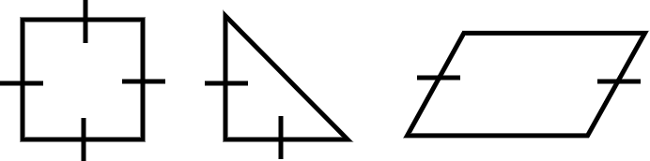

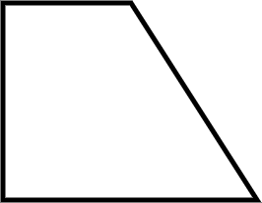
Area of a trapezium
Task A: Building an area
1) State how many of each shape should be used to create a composite shape with the stated area.
a) Area = 24 cm² b) Area = 50 cm² c) Area = 60 cm²
Area = 16 cm² Area = 8 cm² Area = 18 cm²
E.g.
You can use three triangles.
3 × 8 = 24
E.g.
You can use two squares and one parallelogram.
16 + 16 + 18 = 50
E.g.
You can use one square, one triangle and two parallelograms.
16 + 8 + 2 × 18 = 60
Task B: Area of a trapezium via composite shapes
1) Calculate the area of each trapezium.
a) b)
9 cm
17 cm
4 cm
12 cm
5 cm
20 cm
Area = 9 × 17 + (20 - 9) × 17 × ½
Area = 153 + 11 × 17 × ½
Area = 153 + 93.5
Area = 246.5 cm²
7 cm
Area = 5 × 4 + (12 - 5) × 4 × ½
Area = 20 + 7 × 4 × ½
Area = 20 + 14
Area = 34 cm²

Slide 2
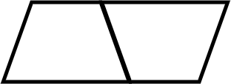
Area of a trapezium
Task C: Formula for the area of any trapezium
1) Instructions:
Take a piece of paper and fold it in half.
Draw a trapezium on your piece of folded paper (try to make it different from mine).
Cut out your trapezium. You should have two identical trapeziums due to your folded paper.
Rotate one trapezium by half a turn. Place the two trapeziums next to each other.
Which quadrilateral did you make?
You have made a parallelogram
Mathematics in Education and Industry.

